Slide 1
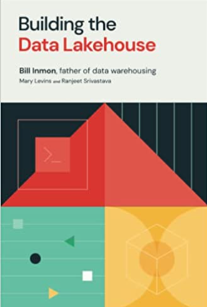
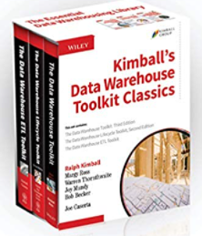
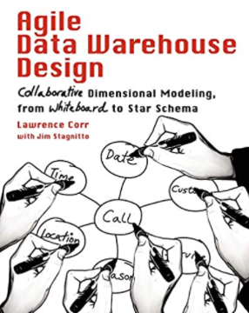
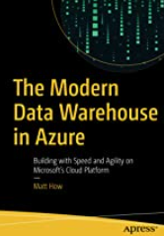
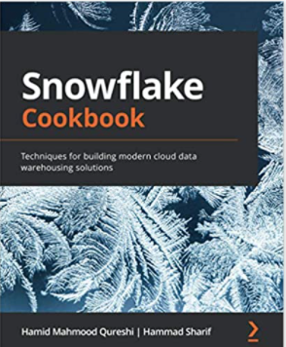
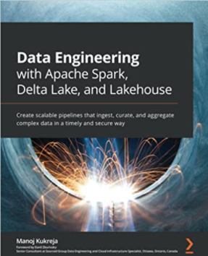

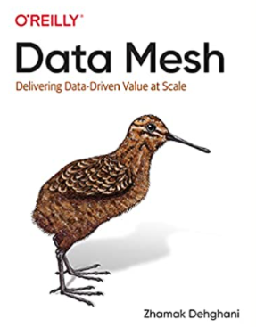
Data Warehouse EVOLUTION
By Marcelo Silva

Slide 2
old tech
Tech | Good | Bad
SMP databases | Tons of features, secure, low cost, highly available | Limited scale, single updatable node
Rowstores | Small grain (8kb), “select *” | Page decomposition (fixed/var length, null/delete bitmaps), slow aggregates, row overflow
Btrees | Various access patterns, index seeks, write optimized | Fragmentation, costly scans
Relational Schemas | Consistency, constraints, routines, triggers | Complex queries, inflexible
Waterfall | Extensive planning, may catch issues before coding | Slow, inflexible, expensive, analysis paralysis
On premise | Dedicated, highly customized | Hardware failures, power supply, security, monitoring, more infra personnel, patching

Slide 3
Old Tech Challenges
High costs and failure rates
Rigid, inflexible systems
High complexity and redundancy
Slow and degrading performance
High latency

Slide 4
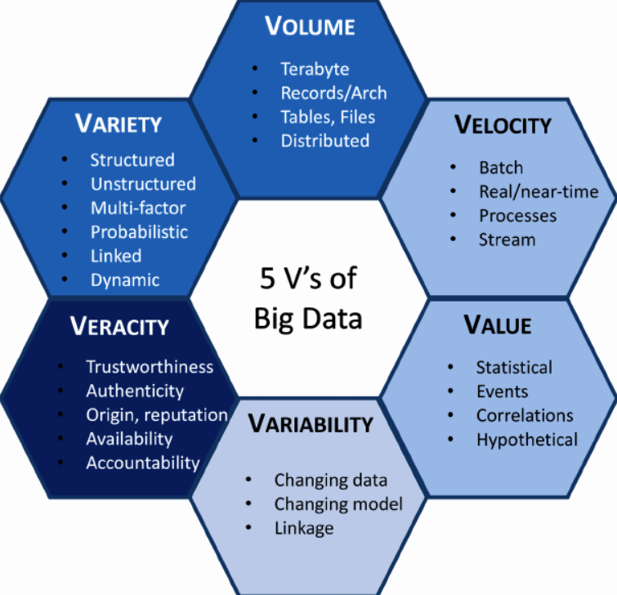
Big data challenges

Slide 5
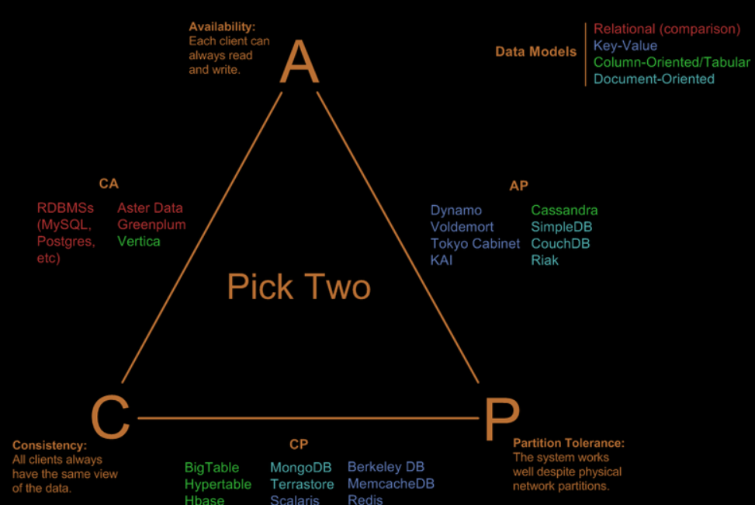
What’s possible
Applies to
Old Tech
New Tech
Future Tech (at least until most of us retire)

Slide 6
New tech
Tech | The Good | The Bad
Column Stores | High compression, segment elimination, aggregate/ predicate pushdown, late materialization, read optimized | Need for large inserts, problems with deletes and updates, row reassembly, costly updates
Agile | Smaller scope, incremental, adaptive | Potential short slightness
DevOps | Testing, Automation, Source Control, infra as code | More code, high investment, overuse, fear of breaking the build
Distributed Compute | More Memory, CPU, IOPs | Data shuffles, distributed query plan complexity, lack of constraints and functionality
Blob Storage | Fast, Elastic, Cheap | Limited access pattern (folder tree), thick grained (whole file), low concurrency, hard to implement complex security (RLA, masking)
Document stores | Schemaless, avoid joins, easy access to complex entities with a parent key | Schemaless, partition limitations with constraints and consistency, cross referencing collections
Cloud / Paas | Lower TCO, secure, extensible, low maintenance, available, accessible | Less customizable, needs more bandwidth
Other database mentions: key/value, column family, graph and time series

Slide 7
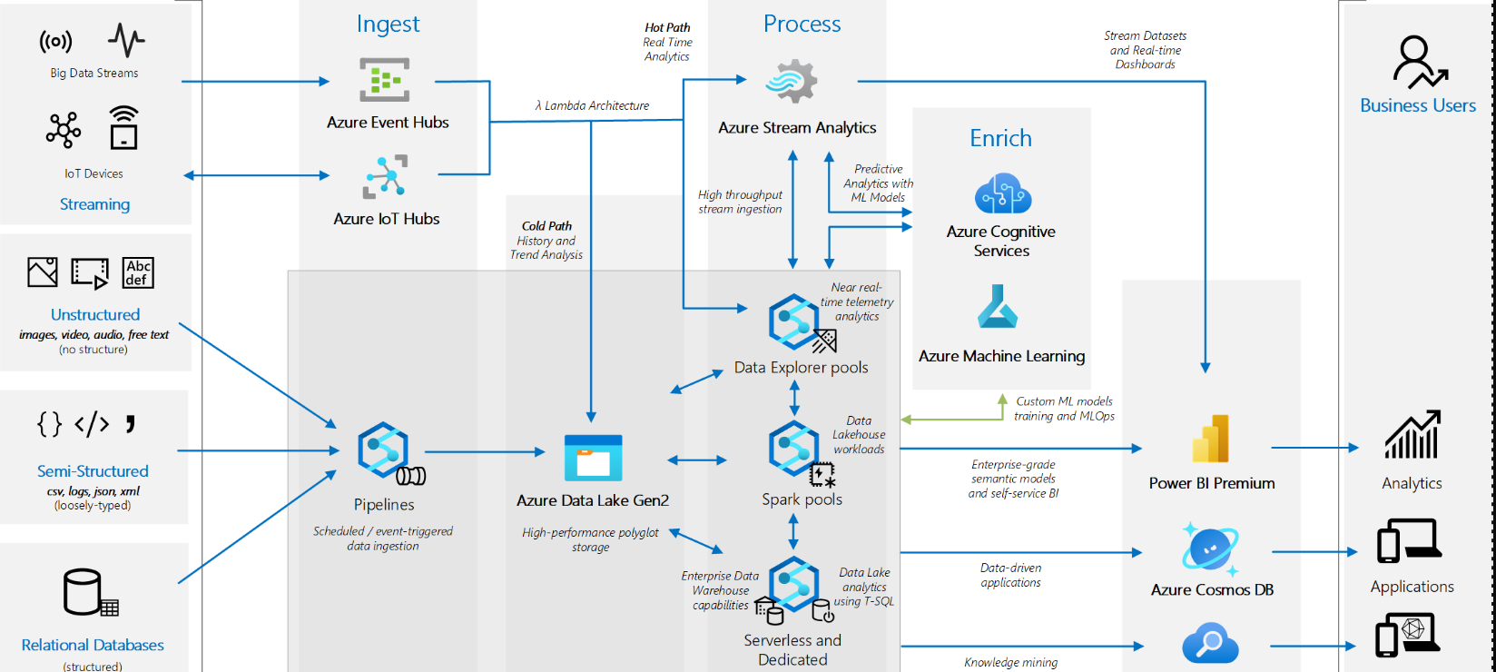
The Microsoft view
Analytics end-to-end with Azure Synapse - Azure Example Scenarios | Microsoft Docs

Slide 8
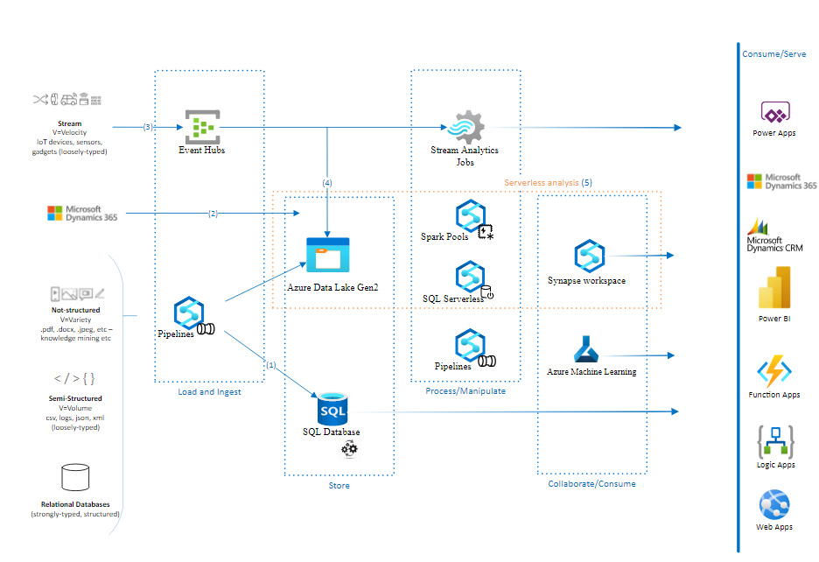
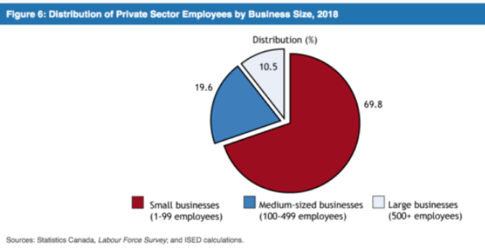
Small/MEDIUM customers
Not much content on MS docs
Fewer icons
Same Data Lake Core
Small mention to SQL
Modern data warehouse for small and medium business - Azure Example Scenarios | Microsoft Docs

Slide 9
How does our architecture help mitigate?
Complexity
Cost
Inflexibility
latency
Is SQL still relevant for analytics?

Slide 10
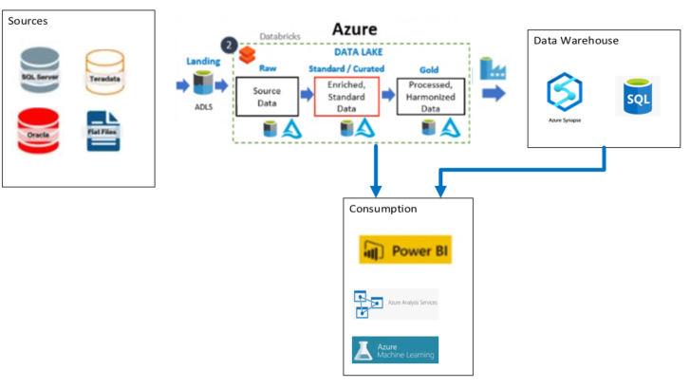
Common Pattern
95% relational sources.
< 100 TB, < 10 GB per day
Large tables are incremental
Small tables truncate/reload
Databricks ELT
Get files from landing zone
Merge tables
Copy files into separate folders (silver/gold) :
Joins, aggregates, change keys, deduplicate, add columns, pivot, unpivot
Select * from table where changedate between X and Y

Slide 11
Common databricks Challenges
Overuse of column stores (parquet) for small volatile tables.
Finding developers.
ACID limited to 1 table.
Limited schema evolution (can’t remove/rename columns or change types). Often need to recreate tables.
Need to enforce data integrity with code.
Implementing complex security (row level access, right to be forgotten, masking).
Low concurrency due to high grain blocking (files) and strict isolation level (WriteSerializable).
Spark is good for handling large jobs over relatively simple schemas. Spark and blob storage are not good to handle a high number of small requests which are often needed by near real time ELT. Streaming works for appendonly workloads but are not good for merges/deletes.
Issues with low latency queries (increased checkpoints, write optimization and auto compaction have compromises).
High Cost (VMs + DBUs + IOPs)
Rudimentary query optimizer produces suboptimal plans for complex queries.
Data shuffling on joins/aggregates not partition aligned.
Parquet (or any column store) has compression issues with updates/deletes. Column stores were designed for processing aggregates and are terrible for frequent merges.
High incidence of scans (when access pattern does not match partitioning/zordering).
Queries without literal filters almost always lead to scans (merging 2 tables for instance). First scan to identify files to be modified and second to rebuild needed files.
Entire files are read and saved (64 MB - 1GB). Too many small files lead to performance issues, large files also lead to performance issues.
Wasted storage until compaction, and compaction is disruptive. Optimize is also disruptive to concurrent writes and is compute expensive.
Queries become slower as logs grow.
Row reassembly cost for wide tables can be significant.
Frequent consequences: Increased complexity, cost, rigidity, latency ☹

Slide 12
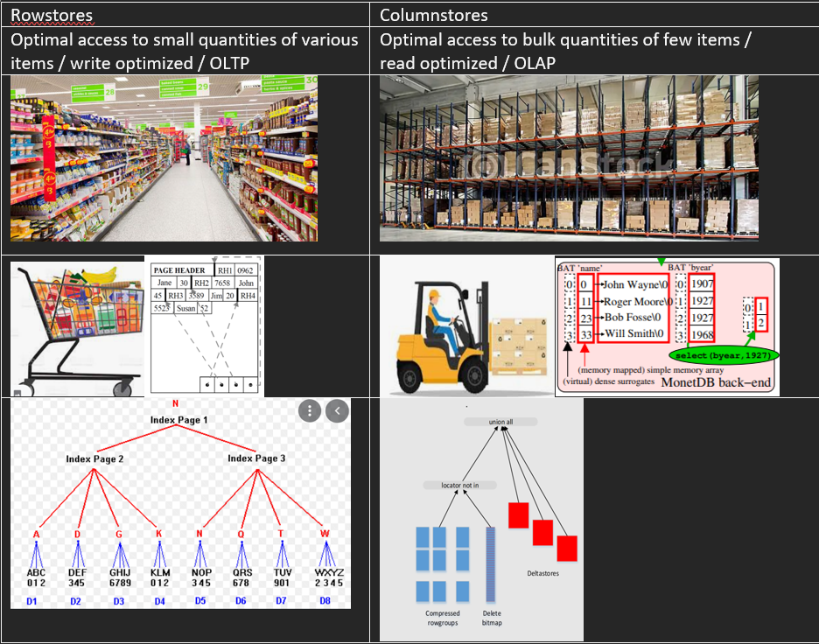

Slide 13
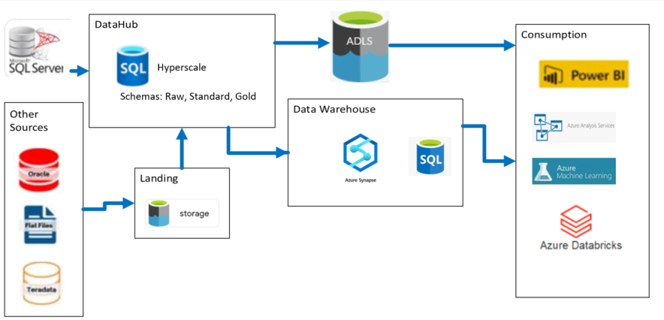
alternative
Use cases
Mostly relational sources
Low velocity, volume, variety
ELT done in SQL
Reuse existing ssis, informatica, …
data lake for retention, exploration
Azure SQL Database Hyperscale FAQ - Azure SQL Database | Microsoft Docs

Slide 14
Advantages
Merges and Extracts can leverage indexes, much faster seeks instead of scans, a few cores may do the same job as a few nodes. Much fewer IOPs. Much less compression/fragmentation issues. No row-reassembly overhead.
Row stores are much more suited for merges and delta extractions than column stores.
Easier to develop, automate, monitor, evolve.
TSQL has more features than SPARK for joins, correlations, subqueries, functions. This means easier ways to solve common problems and lower development cost.
Allows higher concurrency.
Easier to enforce integrity with primary, foreign and check constraints.
Stream data can be consumed with stream analytics.
Tables can leverage RowVersion to feed near real time and historic partitions (lambda architecture).
Hyperscale is Paas (HA, backups, patches covered). Up to 100 TB, 64 vCores and 4 readable secondaries.
Temporal tables can provide time travel/change tracking.
Advanced security features such as row/column level access and data masking to control what subscribers can pull.
Advanced auditing/logging features.
The concept is not new and resembles the ODS (operational data store).
Data lake can still be used for archiving/exploration/ML. We are just moving ELT to SQL. Updating lake tables from SQL with same keys is much easier.
Support for unstructured data can still be done at the lake. SQL already has extensive JSON nested type support, and more improvements are coming in 2022.

Slide 15
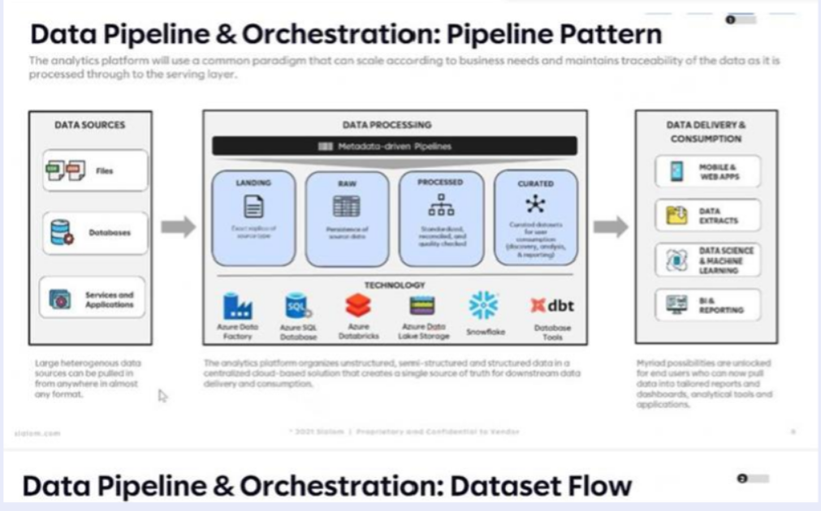
Snowflake view

Slide 16
Open-source utilities to ease development and maintenance:
https://github.com/giraom/CMS
CMS is an open-source utility that allows managing and monitoring SQL Databases on premise and on Azure.
https://github.com/giraom/MSync
MSync is an open-source tool that allows for full and incremental near real time SQL to SQL synchronization with minimal code.
It works with SQL on premise, Azure SQL and Managed Instance as both publisher and subscriber. It was built independently and is distributed as-is, with no warranty. Anyone may use, modify and redistribute at will. Components:
Publisher code. You apply the script in the source database then call proc “rpl.spPublishTable” for each table, which does:
Adds a rowversion column to the table. This column works as a unique auto increment at the database level and gets automatically updated by SQL during inserts and updates. Users cannot tamper with this value. The internal data type is varbinary(8).
Creates an index on the new rv column;
Creates a table to log deleted records with the PK columns;
Creates an after trigger for delete only to log the PK values deleted;
Creates a proc rpl.spGetTableName to be used by the subscribers.
These are the core elements of the change tracking/extraction mechanism. A table must have a PK or unique index for incremental feeds. The PK columns must not be updatable.
Subscriber code. You create the tables empty on the subscriber db, apply the subscriber script, create a subscription and add tables to it, which does:
Creates a staging table to bulk insert results from publisher.
Creates a proc to merge data from staging into the subscribed table.
The MSync tool. This is a command prompt utility written in C# that you execute pointing at the subscriber, and it figures out what/how to copy using metadata during runtime. You may use any scheduler to execute this as often as you wish.

